Slide 1
HISPANIC MINISTRY TEAM Evangelization Event: Festival de Reyes Iglesia Luterana de Cristo, Guayama PR January 5th through 8th of 2024

Slide 2
Iglesia Evangélica Luterana Confesional de Puerto Rico (IELCPR)
A group of 3 volunteers from GSLC went to the 2nd Evangelization Event during the “3 Kings” weekend celebration.
Preparation Phase: Our missionaries joined another group of 5 additional volunteers led by School Counselor Zach Satorious (from Martin Luther Preparatory in Watertown, WI) to start working all pre-coordinated logistical efforts with pastor Sergio Cortijo.
Evangelization work: Flyers were handed out throughout the local community and the public plaza prior to this event. Academia Cristo cards and Christian flyers were given among the visiting guests, while Christian books and toys were given to all children during this family event.

Slide 3
Preparation Phase

Slide 4
Sunday Morning Service

Slide 5
Final Preparations on the Event’s Day…

Slide 6
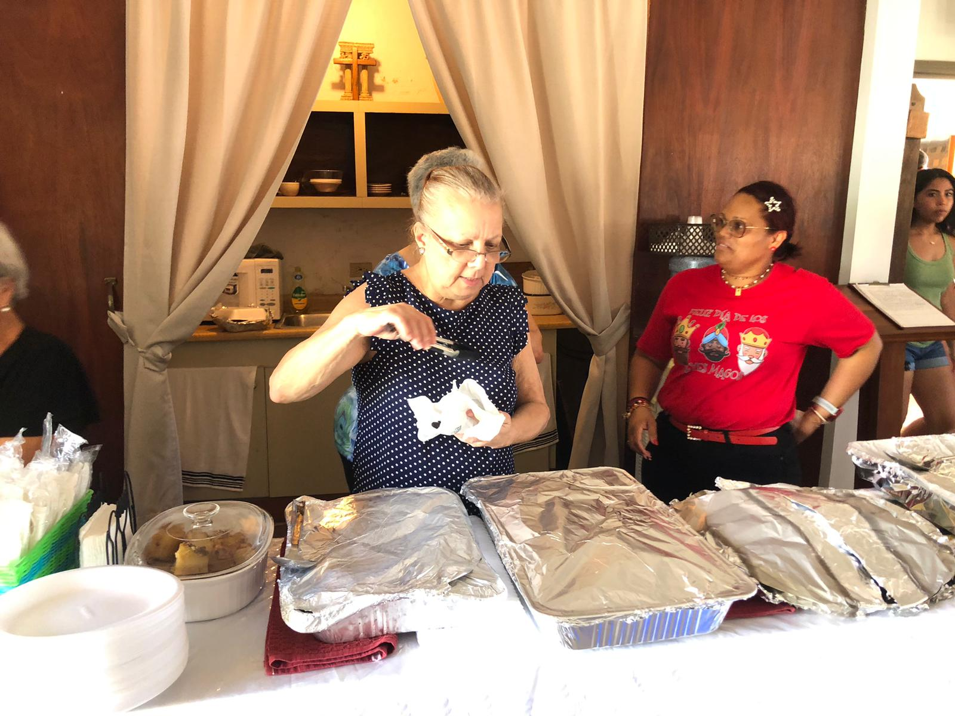
Almost There…

Slide 7
¡Festival de Reyes!

Slide 8
PR Evangelization Event – Festival de Reyes

Slide 9
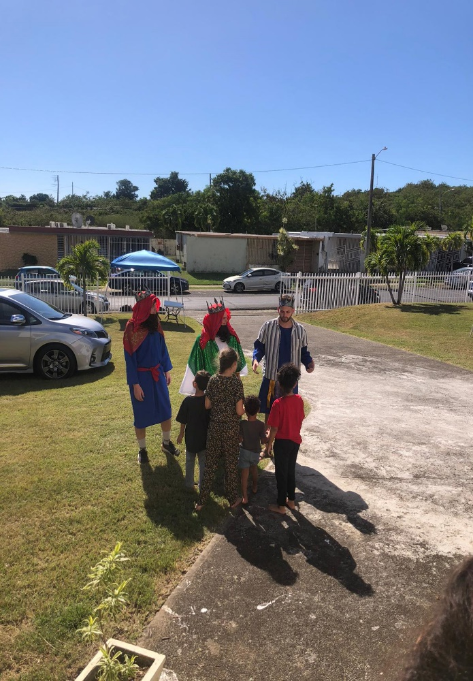
PR Evangelization Event – Festival de Reyes

Slide 10
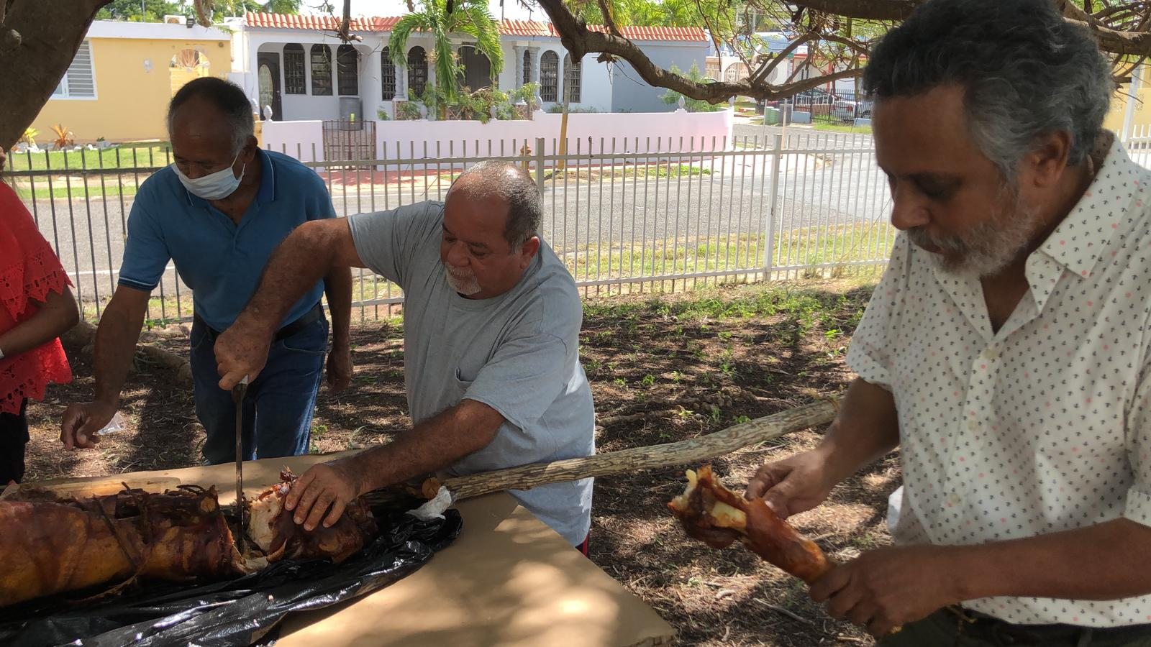
PR Evangelization Event – Festival de Reyes

Slide 11
PR Evangelization Event – Festival de Reyes

Slide 12
Post-Event’s Final Notes:
20 to 25 families attended the event on Sunday, Jan. 7th (around 60-70 persons) and half of that people were children - between 30 to 35 total.
All guests were invited to the next Sunday service…3 families didn’t have any affiliation with CELC congregations in PR, or any other Christian churches. None of those families attended the Sunday service that followed this event, however, 3 children out of 2 of those families were registered in the church’s confirmation class.
Pastor Cortijo is closely following up with these families, as well as, the remaining guests & families that attended to this event.

