Slide 1
HISPANIC MINISTRY TEAM Evangelization Event: Festival de Reyes Iglesia Luterana de Cristo, Guayama PR January 4th through 9th of 2023

Slide 2
Iglesia Evangélica Luterana Confesional de Puerto Rico (CELC)
A group of 3 volunteers from GSLC went to the 1st Evangelization Event during the “3 Kings” weekend celebration.
Preparation Phase: Our missionaries joined another group of 8 additional volunteers led by pastor Tim Satorious (Mission Journeys Liason for PR) to start working all pre-coordinated logistical efforts with pastor Sergio Cortijo.
Evangelization work: Free concerts were offered by the musicians at the plaza in Guayama to promote the event, as well as, handing out event flyers throughout the local community. A.C. cards and Christian flyers were given to all adults, while Christian books and toys were given to all children during this family event.

Slide 3
Preparation Phase

Slide 4
Final Preparations on the Event’s Day…

Slide 5
A Few More…

Slide 6
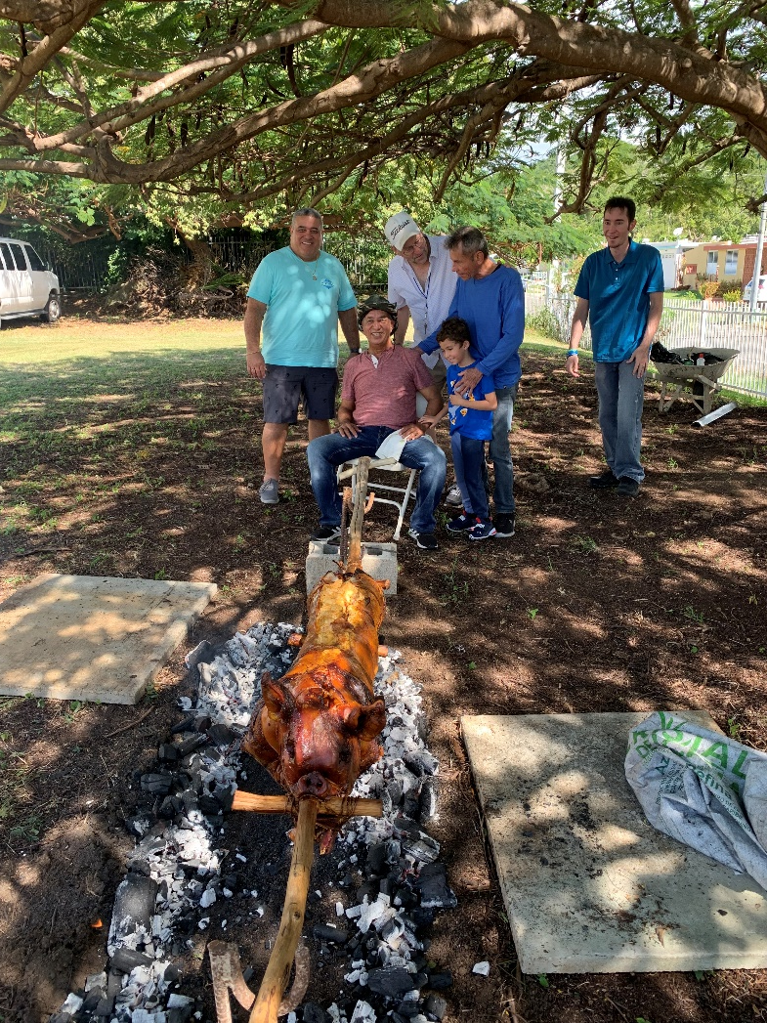
Almost There…

Slide 7
¡Festival de Reyes!

Slide 8
PR Evangelization Event – Festival de Reyes

Slide 9
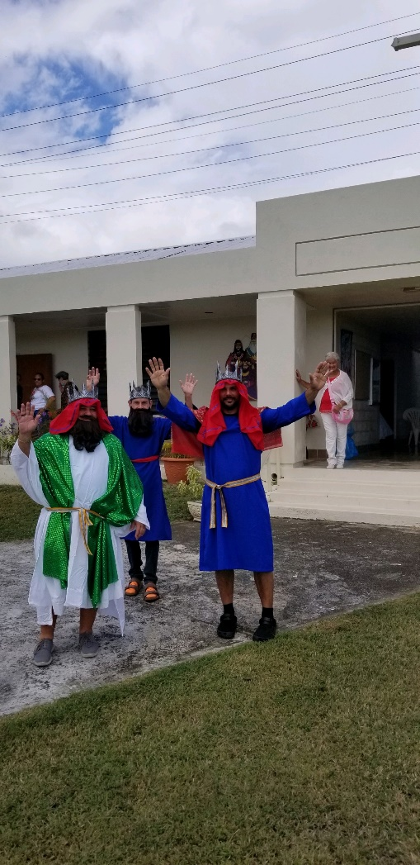
PR Evangelization Event – Festival de Reyes

Slide 10
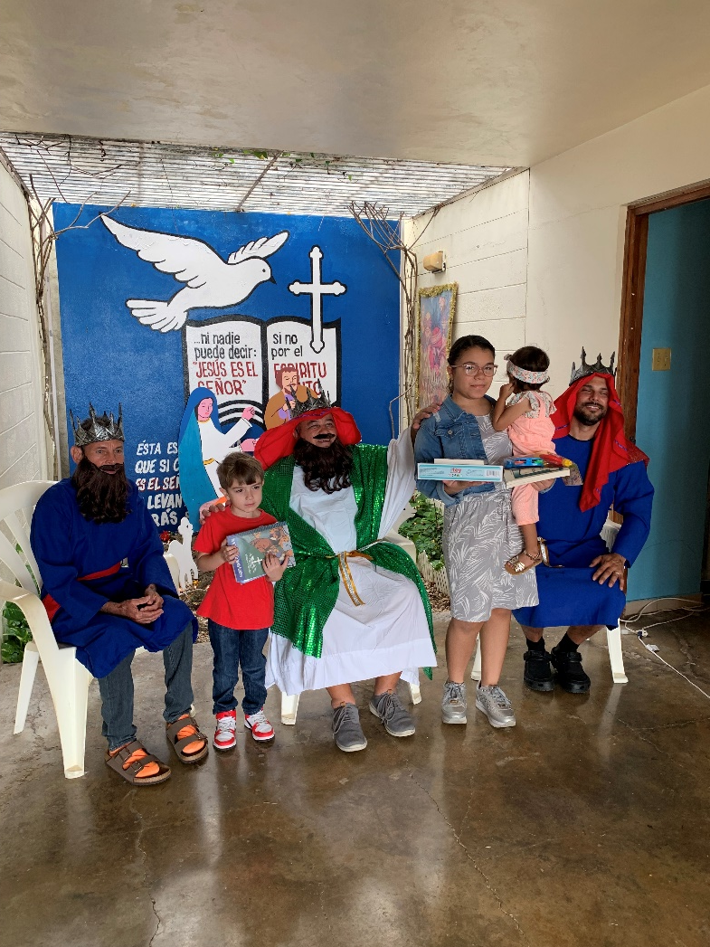
PR Evangelization Event – Festival de Reyes

Slide 11
PR Evangelization Event – Festival de Reyes

Slide 12
Post-Event’s Final Notes:
35 to 40 families attended the event on Saturday, Jan. 7th (around 100-120 persons) and half of that people were children - between 50 to 60 total.
All registered guests were invited to the next day’s service…5 families didn’t have any affiliation with CELC congregations in PR, or any other Christian churches. One of those families accepted the invitation and still currently attending the Sunday service (as of the beginning of March).
Pastor Cortijo is closely following up with this family (3 potential new members) as well as, the remaining guests/families from this event’s list.

