Slide 1
HISPANIC MINISTRY TEAM
TRIP TO: IGLESIA LUTERANA DE CRISTO
(PASTOR: SERGIO CORTIJO)
GUAYAMA, PUERTO RICO
June 6th to June 13th of 2023

Slide 2
Iglesia Evangélica Luterana Confesional de Puerto Rico (CELC)
A group of 8 volunteers from GSLC went to the 3rd mission trip to the island.
Work Itinerary: 8:00 am, breakfast / 8:30 am-2:30 pm, works at church / 2:30 pm, late lunch & recess (Wednesday & Thursday).
Works performed: scraping & painting the front metal fence of the church to include cutting grass and general yard cleaning around the church building.
Evangelization work: Academia Cristo cards were handed out in the city of Humacao on Friday, around the community of our other sister church in the island. Also, on Saturday morning at the local plaza in Guayama and then at the public plaza of Ponce city in the afternoon.

Slide 3
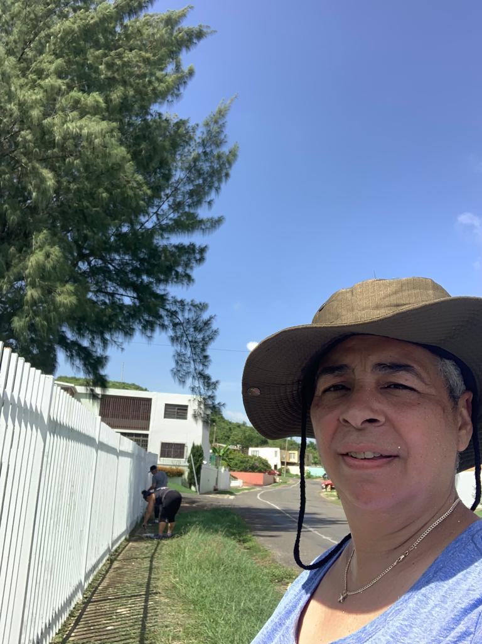
Church Works – Fence Scraping & Painting

Slide 4
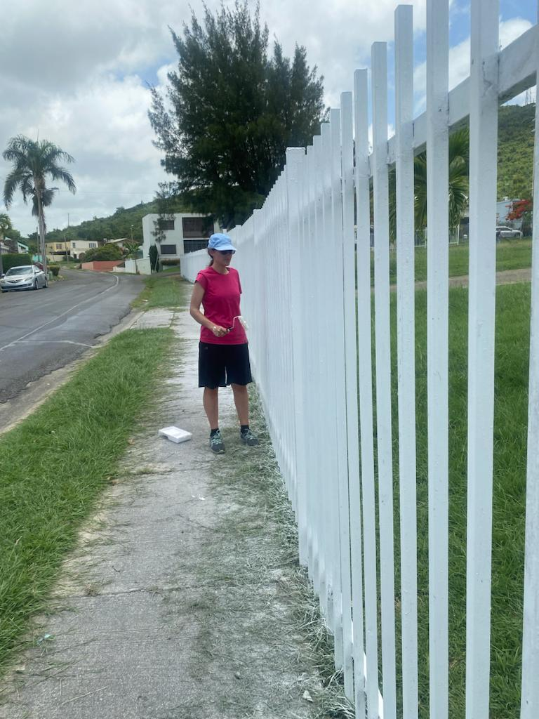
Fence Painting

Slide 5
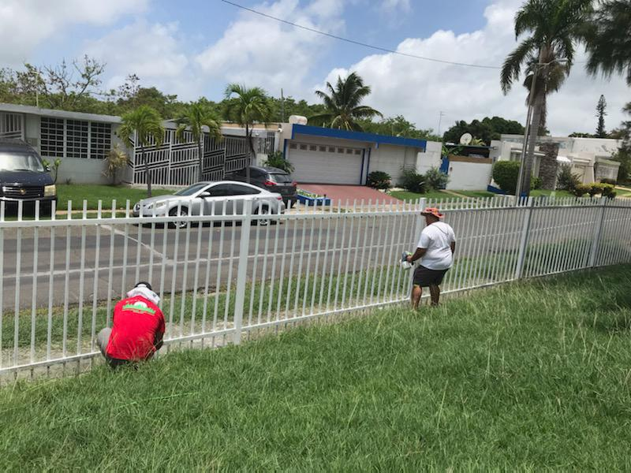
Yard Work & More Painting

Slide 6
Pre-Evangelization Devotional

Slide 7
Evangelization Day 1 - Humacao

Slide 8
Evangelization Day 1 - Humacao

Slide 9
Evangelization Day 2 - Guayama

Slide 10
Evangelization Day 2 - Ponce

Slide 11
Down Time Pictures – El Morro & El Yunque

Slide 12
Castillo Serrallés & Mrs. Erin’s Birthday!

Slide 13
The Cliffs at “El Faro” – Cabo Rojo

Slide 14
Final Notes:
Location for next trip is: San Juan, Puerto Rico.
Scheduled for: June 4th through June 11th of 2024.
Goal: The main purpose for this trip will be the evangelization in the highest populated area of the island, where the power of the Gospel could be spread through the Academia Cristo resources to more people (expanding the grounds to sow its seeds).
Remarks: More information will be put out toward the end of the year, in the meantime, please continue to pray for this ministry.

